Slide 1
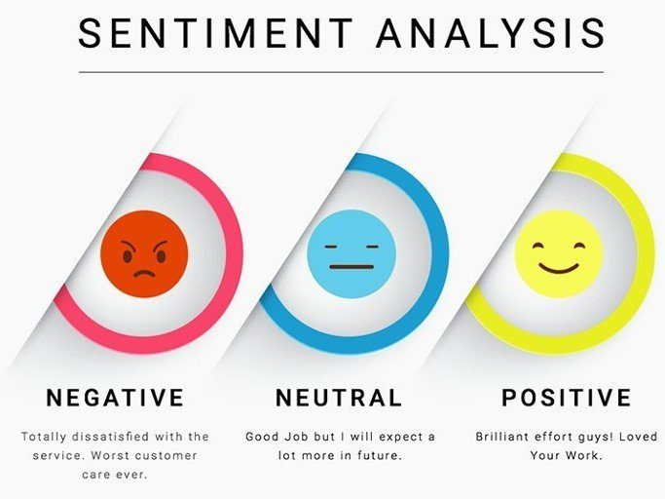
Sentiment Analysis: Empowering PUBG Developers
Sentiment analysis is vital in natural language processing for understanding user sentiments towards products or services. It provides valuable insights into customer feedback, enabling developers to make informed decisions.

Slide 2
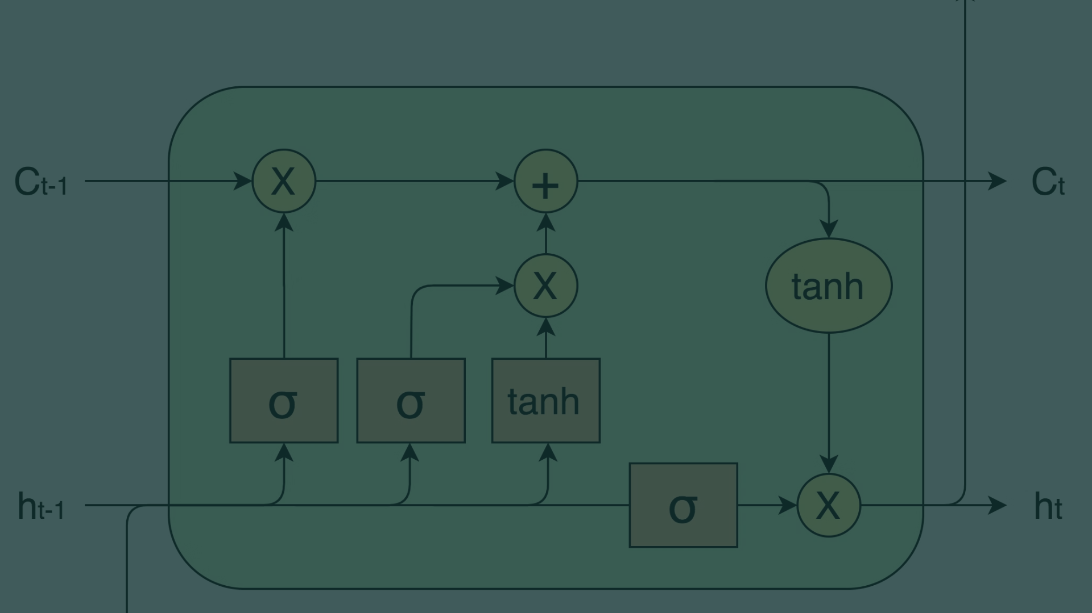
Understanding LSTM Networks
1
Functionality
The unique architecture of LSTM networks allows for the retention and use of long-term dependencies in sequences of data.
2
Applications
LSTM networks are widely used in various text analysis tasks, including sentiment analysis, language translation, and text generation.
3
Enhancements
Continuous improvements and modifications have optimized LSTM networks for handling complex natural language processing tasks.

Slide 3

PUBG Game Reviews Dataset
1
Scope
2
Volume
The PUBG game reviews dataset offers a diverse range of user sentiments and feedback, providing a rich source for sentiment analysis.
It comprises a substantial number of reviews, ensuring a comprehensive analysis of the sentiments expressed by players.
3
Validity
These authentic reviews reflect the genuine experiences and opinions of PUBG players, contributing to the credibility of the dataset.

Slide 4
Data Preprocessing for Analysis
Cleaning
Normalization
The dataset is cleaned to remove irrelevant content, ensuring the sentiment analysis is based on valuable and accurate data.
Text is standardized through processes like tokenization and lemmatization to ensure consistency and coherence in analysis.
Feature Extraction
Relevant features, such as sentiment-bearing words and phrases, are extracted to create meaningful data for analysis.

Slide 5
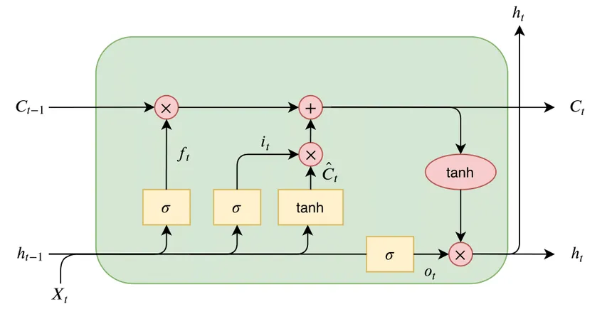
Training the LSTM Network
Optimization
Validation
Hyperparameter Tuning
Cross-Validation
Fine-tuning model parameters to optimize accuracy and enhance the network's ability to discern nuanced sentiments.
Ensuring model generalization by validating its performance on multiple subsets of the dataset.

Slide 6



Evaluating Model Performance
Accuracy
Precision
Recall
Measuring the percentage of correctly identified sentiments, indicating the network's precision in analysis.
Evaluating the ratio of correctly identified positive or negative sentiments to the total predicted positives or negatives.
Assessing the capability of the network to identify all relevant sentiments from the reviewed comments.

Slide 7



Key Insights and Discussion
Positive Sentiments
The network effectively captures player satisfaction, showcasing the game's strengths and enjoyable aspects.
Constructive Criticism
Insights into areas for improvement based on user feedback, aiding in refining the gaming experience.
Uncovering Trends
Identification of recurring sentiments, providing valuable data for strategic decisions by developers and marketers.

Slide 8
Future Directions and Conclusion
Enhanced User Feedback Analysis
Integration of advanced sentiment analysis techniques to glean deeper insights from player comments.
Real-time Sentiment Monitoring
Developing systems to continually monitor and analyze user sentiments to facilitate prompt responses to emerging trends.
Interactive Data Visualization
Utilizing dynamic and visually impactful representations of sentiment analysis results for enhanced stakeholder understanding.

Slide 9
Exploring the Impact of Sentiment Analysis in PUBG Game Development
In this engaging presentation, we will delve deep into the fascinating world of sentiment analysis and its significant impact on PUBG game development. Join us as we embark on a journey to uncover the hidden insights within the vast landscape of player reviews. Through the application of advanced natural language processing techniques, we will explore how sentiment analysis can empower PUBG developers to gain valuable understanding of player sentiments, preferences, and feedback.
By analyzing the extensive PUBG game reviews dataset, we aim to unveil key patterns, sentiments, and trends that can shed light on the player experience. Through this analysis, we will provide actionable recommendations and innovative strategies for enhancing the gaming experience to new heights.
Get ready to immerse yourself in an enlightening exploration of sentiment analysis and its profound implications for PUBG game development. Let's dive in and discover the exciting possibilities together!

